Slide 1
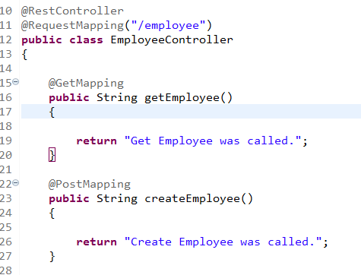
Spring Boot – Adding Methods to Handle POST,GET, PUT, DELETE HTTP requests

Slide 2
Spring Boot – Returning Object as JSON or XML Representation
https://www.udemy.com/course/restful-web-services-with-spring-framework-a-quick-start/learn/lecture/11769884#overview

